Slide 1

A Census-Tract Based Analysis on Exploring Rideshare Usage Pattern using K- Means for the City of Chicago in the era of pandemic
CSCE 5063: MACHINE LEARNING
Project Update Presentation
PRESENTED BY
SHAKIL AHMED RAFI (010782622)
ARNA NISHITA NITHILA (010972702)

Slide 2

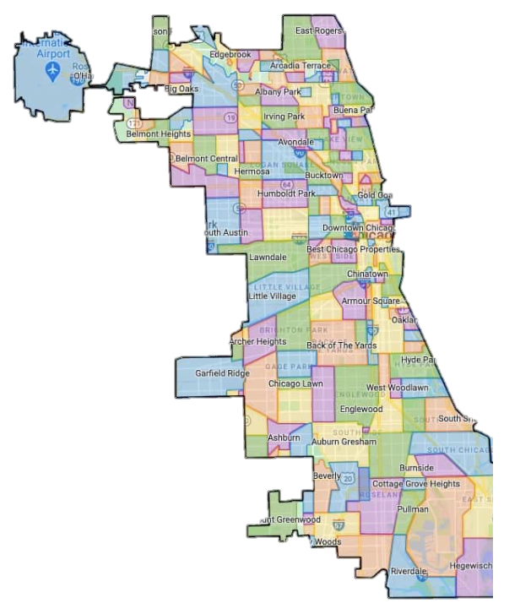
BACKGROUND OF THE STUDY
Exploring the usage of Ride-sharing (e.g. Uber, Lyft, and Didi) based on census-tract level analysis is crucial for understanding the socio-demographic characteristics of users within the complex urban system (Schaller, 2018; Alemi et al., 2018).
The goal of the study is to understand the characteristics of ride-sharing users based on census-tract level ride-share trips data, socio-economic and built-environment attributes for Chicago City using K-means.
Since our dataset contains numerical variables, K-means to identify the main ride-sharing profiles with regards to trip attributes, and other socio-demographic characteristics.
BACK-
GROUND
GOAL
K-Means

Slide 3
DATA AND SOURCE
Time Frame :July 01- July 31, 2020
Table 1: Variables used for ride-share users’ clustering for the City of Chicago
Category | Variables | Unit | Data Source
Trip Characteristics | Trip Count | Number | Chicago Data Portal
 | Trip Distance | Miles | Chicago Data Portal
 | Trip Duration | Seconds | Chicago Data Portal
Socio-Demographic Characteristics | Median Income | $ | American Community Survey
 | Median Age | Number | American Community Survey
Built Environment | Population Density | People/ acres | Smart Location Database
 | Employment density | Jobs/acres | Smart Location Database
 | Land-use mix | - | Smart Location Database
 | Percent of Zero Car Ownership | percentage | Smart Location Database
 | Distance from nearest transit stops | meters | Smart Location Database

Slide 4
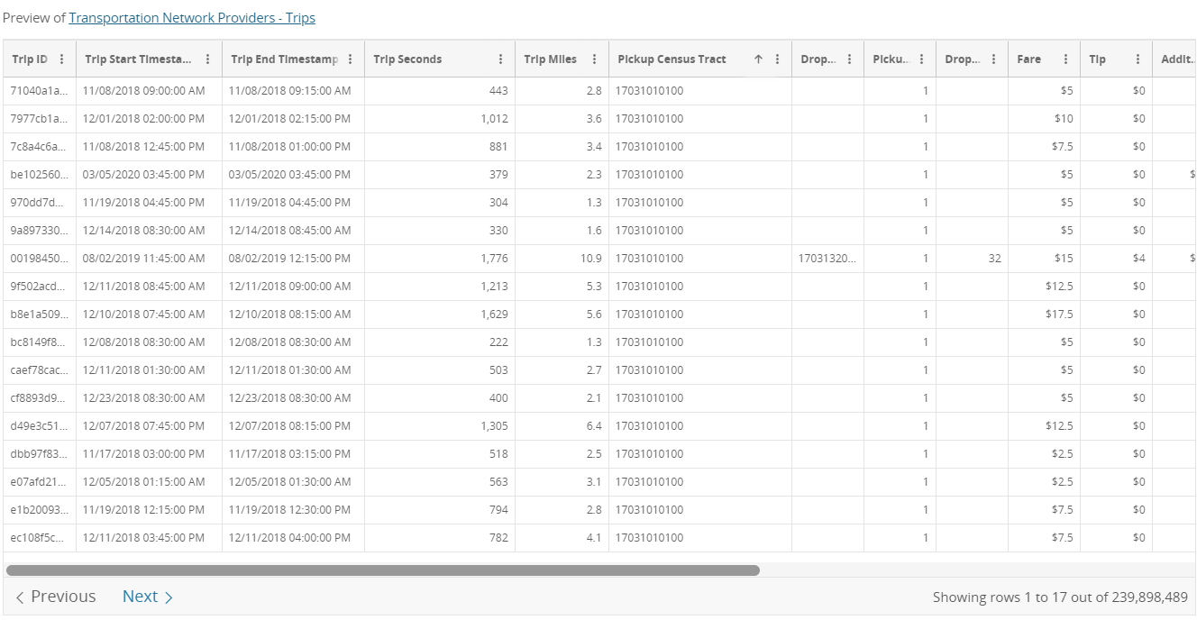
DATA AND SOURCE
Pick-Up Count
Dataset
Dataset Name: Chicago Data Portal
Dataset contains
Individual pick-up information
their trip IDs,
Trip duration,
Fare,
Trip miles, etc.
Data Source:
https://data.cityofchicago.org/Transportation/Transportation-Network-Providers-Trips/m6dm-c72p/data
Data Size: Approximately 3 million trips

Slide 5
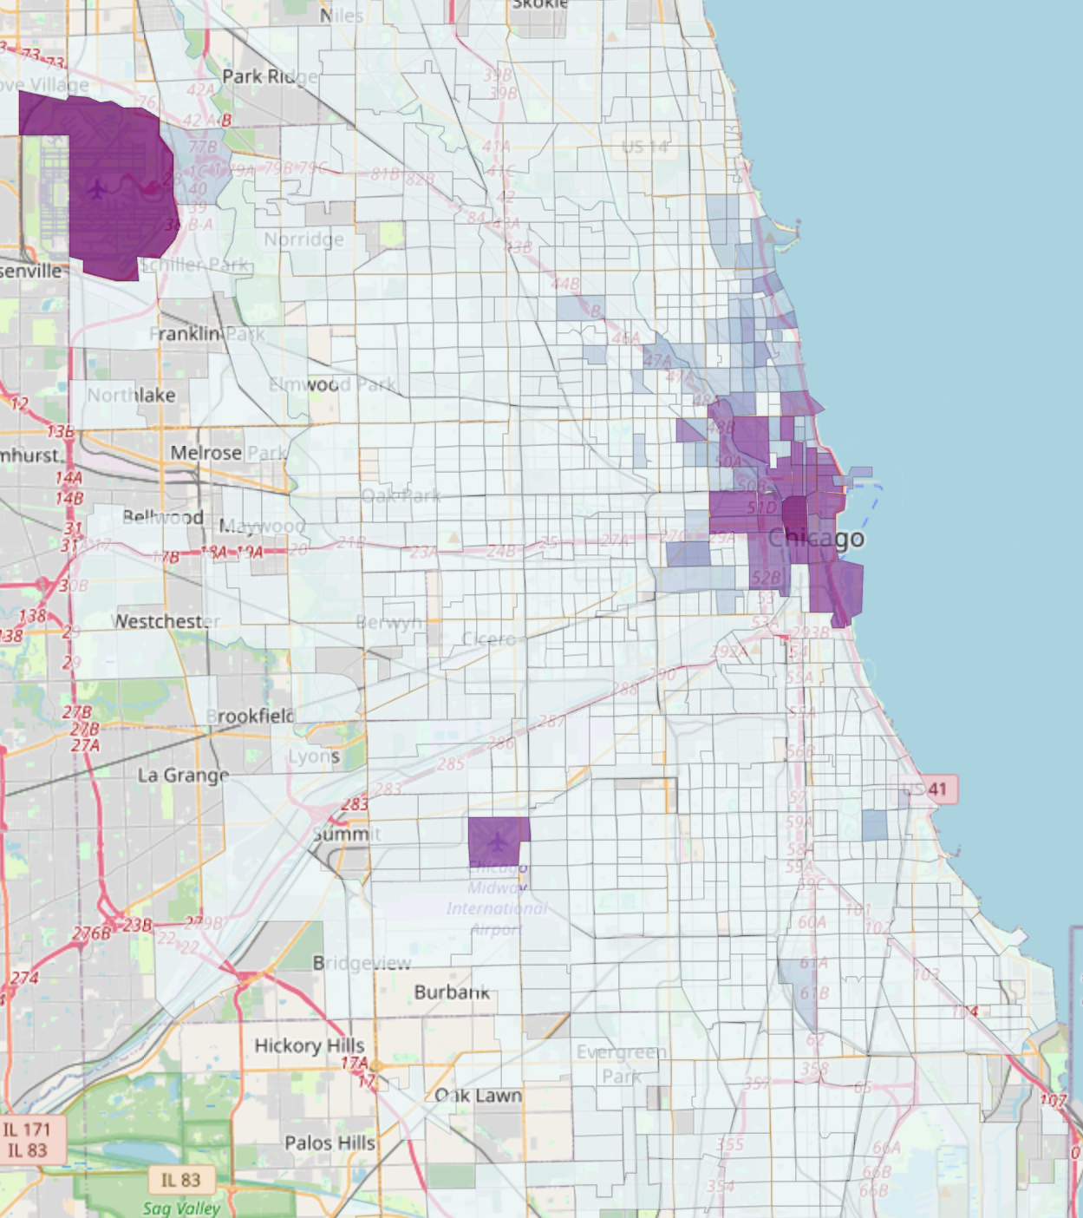
DATA AND SOURCE
Pick-Up Count
Dataset
Individual pick-up data given on census-tract co-ordinates
Data has a large variance.
The two airports ORD and MDW has high pickups.
Trips are aggregated based on census-tract
Total Trip count for each census tract

Slide 6
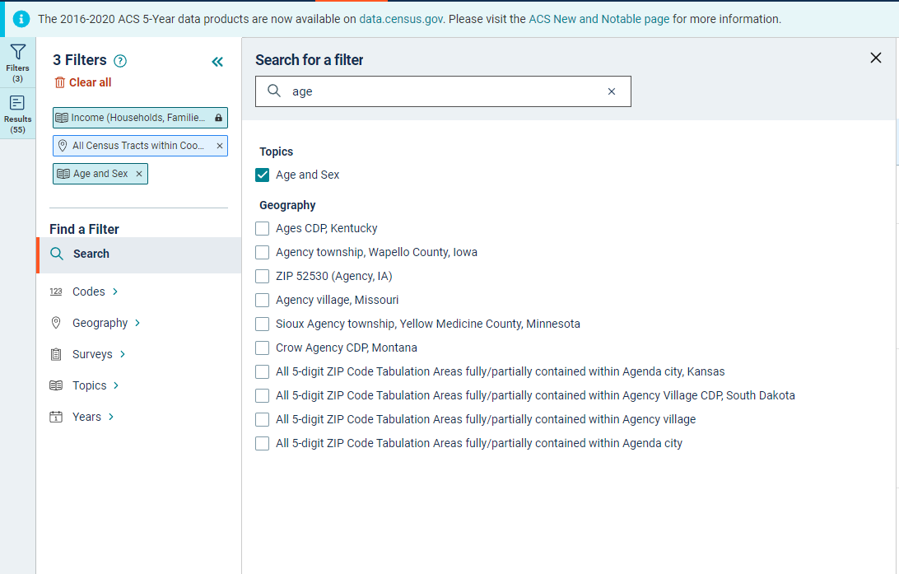
DATA AND SOURCE
Pick-Up Count
Median Income and Age
Dataset Name: The 2016-2020 American
Community Survey
Dataset contains
All socio-economic information at the
Population and household-level.
Data Source:
File Size:3.6 MB
https://data.census.gov/cedsci/table?q=income&t=Age%20and%20Sex&g=0500000US17031%241400000
Data are filtered out based on variable name ( eg. Income, Age)
Data are filtered out based on Census tract> Cook County
Data on Median Income and Age

Slide 7
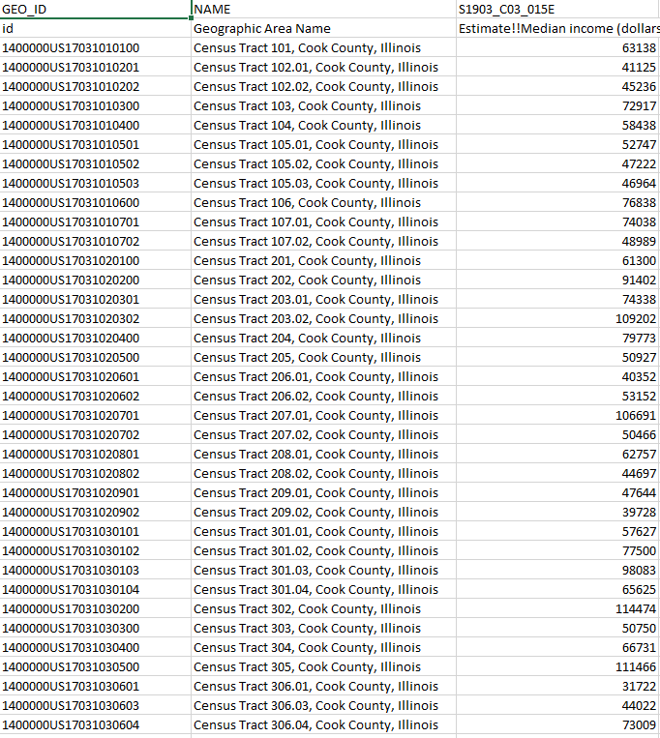
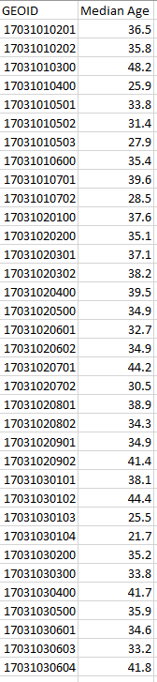
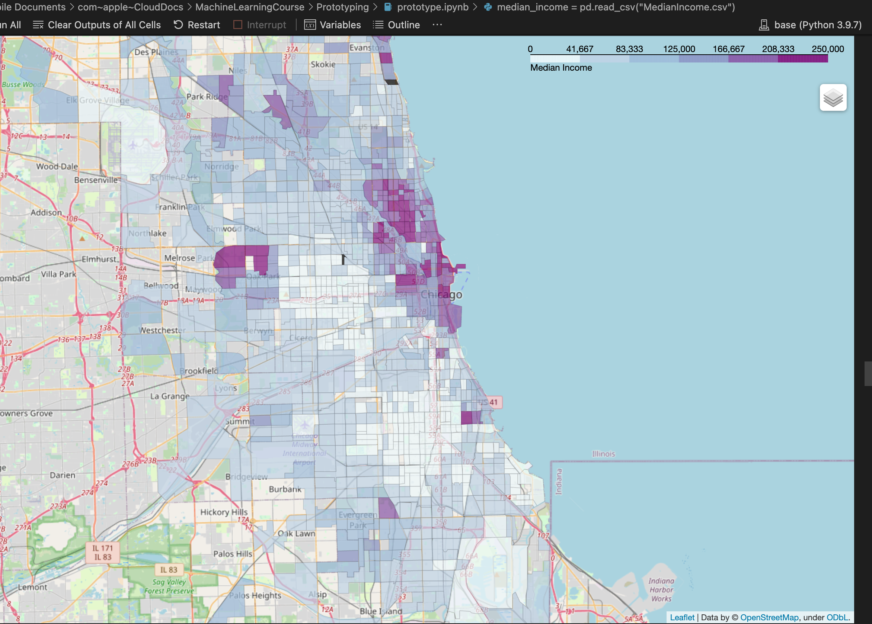
DATA AND SOURCE
Median Income and Age
Most census tracts with high median income are near
the town center near Lake View and Wrigleyville
The airport census tract has NaN Income, replaced by 0.

Slide 8
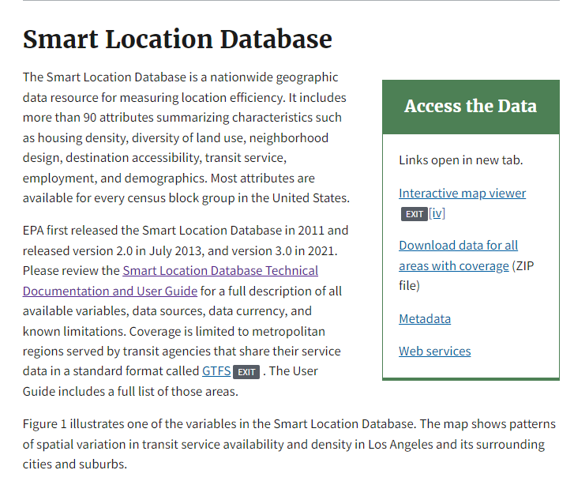
DATA AND SOURCE
Built Environment Variables
Dataset Name: Smart Location Database
Dataset Theme : Transportation Network,
Society and Demography, Environment and
Conservation, Cultural for all 50 states
Total Variables: 169 variables
File Size: 681 MB
Data Source:
https://www.epa.gov/smartgrowth/smart-location-mapping
Go to the website
Download link given on the website

Slide 9
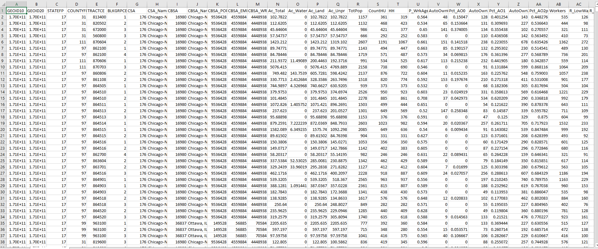
DATA AND SOURCE
Built Environment Variables
Manual on full description of Data are given
Data on Population Density, Employment Density, Percent of Zero Car ownership, Land-Use Diversity
Data are filtered out based on Census tracts of Chicago city
Filter out the codes for selected variables

Slide 10
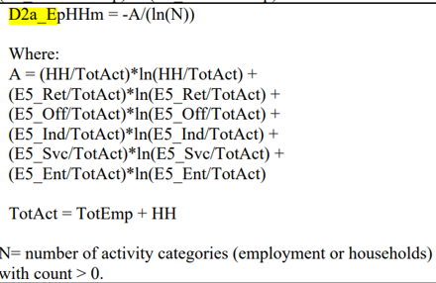
DATA AND SOURCE
Built Environment Variables
Variable Code ( Based on Manual ) | Definition
D1a : Population Density | Total Population/ Total area coverage ( acre)
D1c : Employment Density | Jobs/ Acre
D2a_EpHHm: LandUse Diversity
D4a: Distance from transits | The minimum walk distance in meter between the population weighted census tract centroid and the nearest transit stop of any route
Manual on full description of Data are given
Data on Population Density, Employment Density, Percent of Zero Car ownership, Land-Use Diversity
Data are filtered out based on Census tracts of Chicago city
Filter out the codes for selected variables

Slide 11
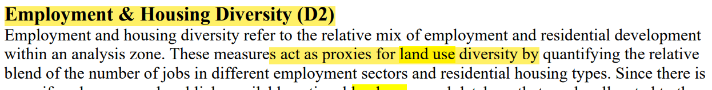
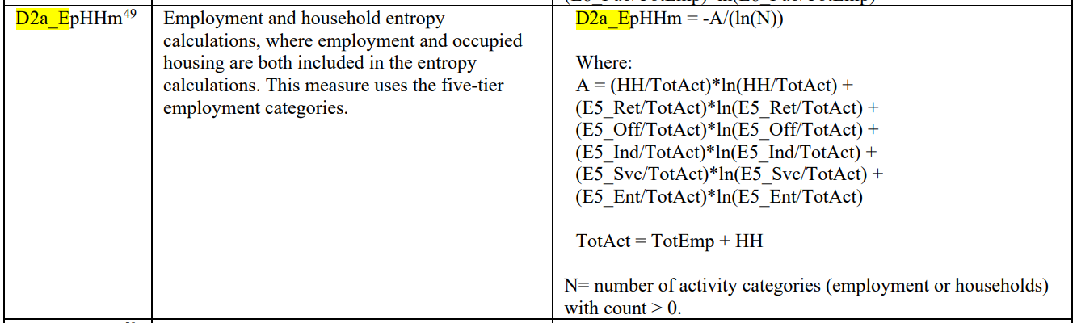
DATA AND SOURCE
Built Environment Variables
Document Link : https://www.epa.gov/smartgrowth/smart-location-database-technical-documentation-and-user-guide

Slide 12
DATA AND SOURCE
Data Cleaning and Preparation of Main Dataset for Analysis
Download data as CSV from different sources and read it using Pandas
Dataset_cleaned
Population Density >0
Clean up data using dropna()
Distance from Transit >= 0
Convert columns to the appropriate data types
Median Income > 0
Dataset_Cleaned
LanUse diversity > 0

Slide 13
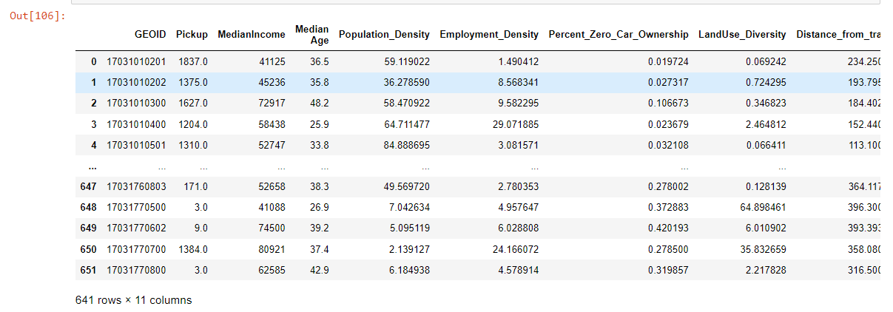
DATA AND SOURCE

Slide 14


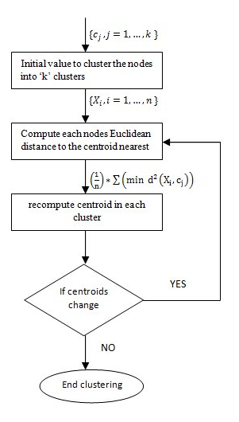
FRAMEWORK for K-means Clustering
Variables
For handling data frames
Pandas
For fast numerical computations
and as the back-end to Pandas
Numpy
For its rich ecosystem of machine learning tools including K-means
Scikit-
Learn
Framework Source: https://medium.datadriveninvestor.com/k-means-clustering-b89d349e98e6

Slide 15
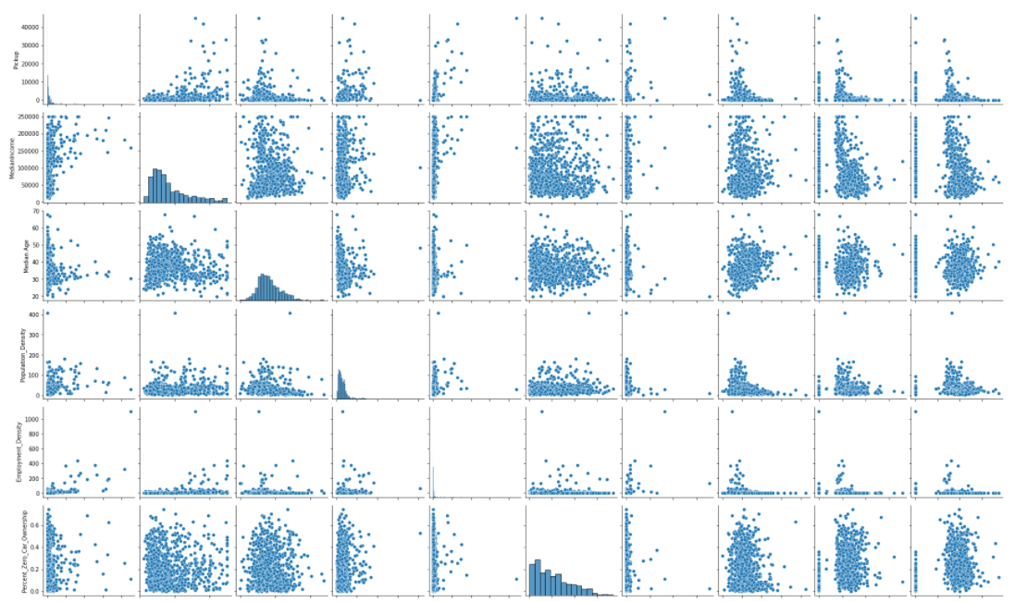
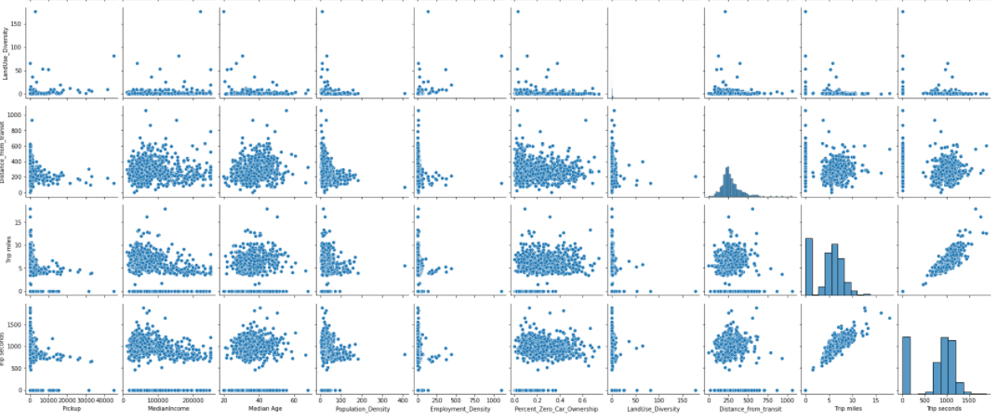
Output ( Scatter Plot and Correlation Heat map)

Slide 16
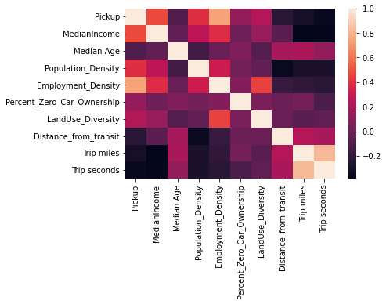
Output ( Scatter Plot and Correlation Heat map)
Interesting observations:
1. Distance from transit is weakly inversely correlated with
Number of pickups
2. Employment density is strongly correlated with
Number of pickups
3. High median income tracts tend to have lower trip
Miles and trip seconds
4. The higher the population density the lower
The distance from transit
5. Percentage of people with zero car density has
a weak correlation with number of pickups.

Slide 17
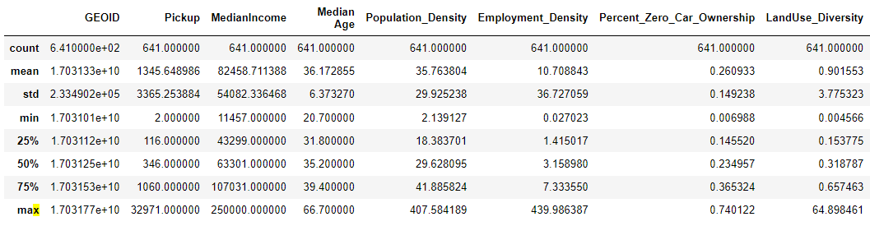
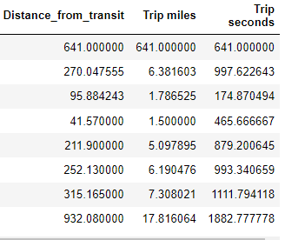
Output ( Descriptive Statistics)

Slide 18
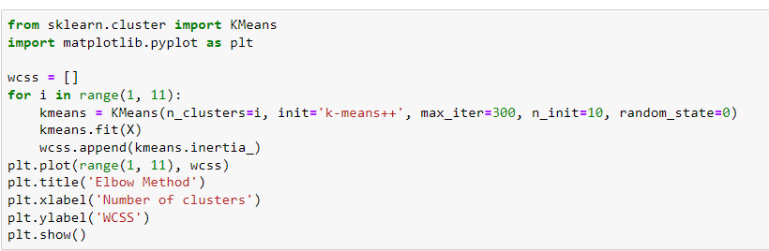
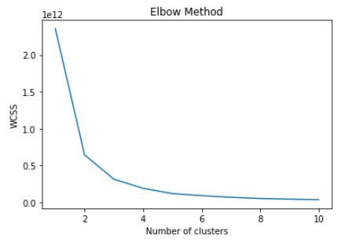

Output
Elbow method shows that three clusters will be optimal

Slide 19
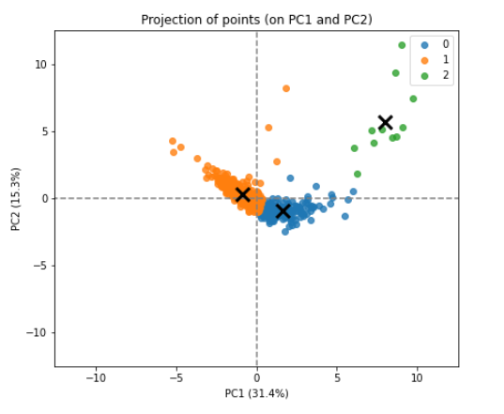
Output ( Visualizing Clusters)
Create a PCA Model for reducing dataset for 2D Visualization
Transfer the scaled data to the new PCA space
Convert to a data frame
Show and display data points and the cluster centres
https://openclassrooms.com/en/courses/5869986-perform-an-exploratory-data-analysis/6177861-analyze-the-results-of-a-k-means-clustering#:~:text=Interpreting%20the%20meaning%20of%20k,of%20what%20each%20cluster%20represents.

Slide 20
Output ( Visualizing Clusters)

Slide 21
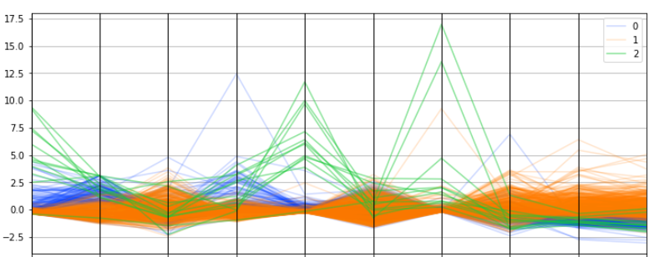
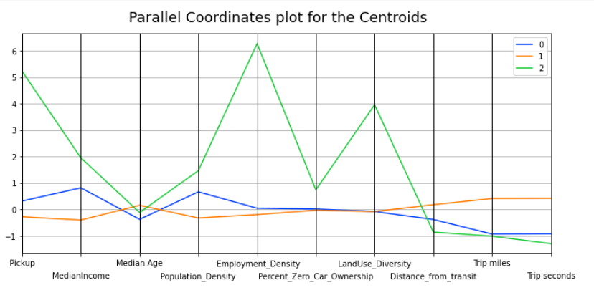
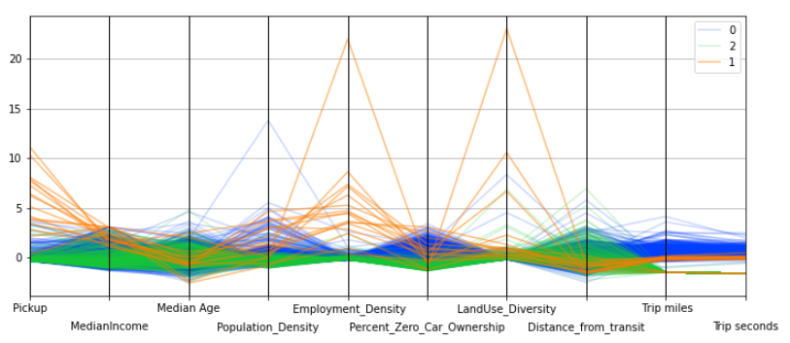
Output (Cluster_2)
Cluster_2: Census Tracts with High Income
Built-Environment Characteristics
HIGH POPULATION DENSITY
Trip Characteristics
Socio-Economic Characteristics
HIGH NUMBER OF PICK-UPS
HIGH LAND-USE DIVERSITY
HIGH MEDIAN INCOME
SHORT TRIP DISTANCE AND DURATION
HIGH EMPLOYMENT DIVERSITY

Slide 22
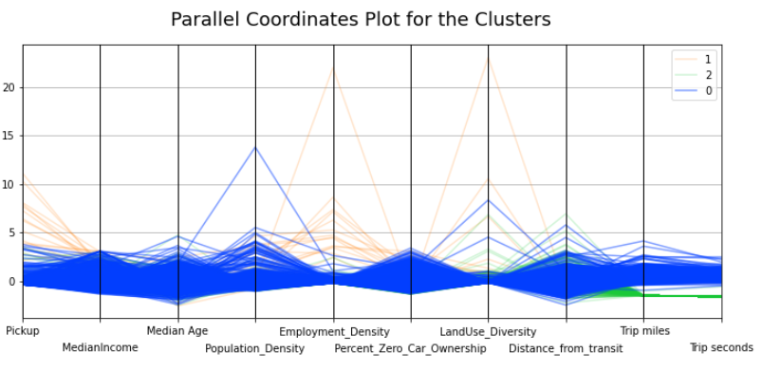
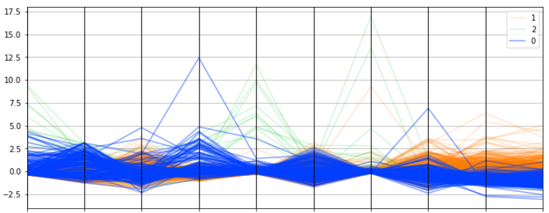
Output (Cluster 0)
Cluster_0: Census Tracts with Middle Income
Trip Characteristics
Built-Environment Characteristics
MEDIUM NUMBER OF PICK-UPS
Socio-Economic Characteristics
LOW LAND-USE DIVERSITY
LOW MEDIAN INCOME
LONG TRIP DISTANCE AND DURATION

Slide 23
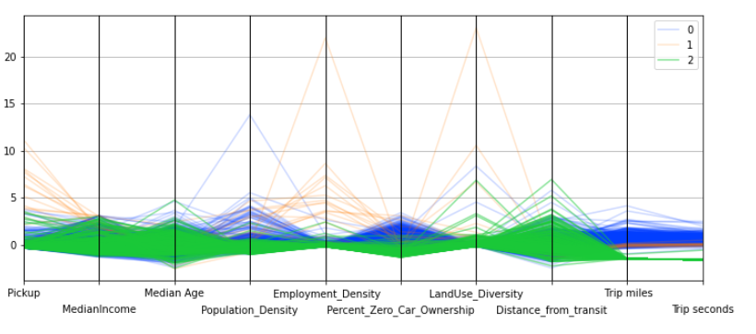
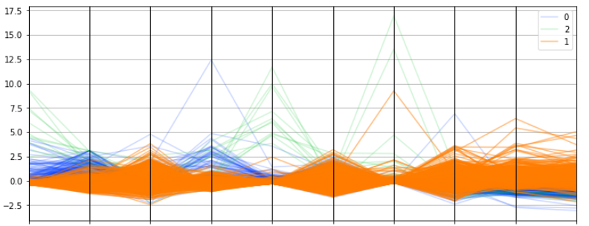
Output (Cluster 1)
Cluster_1: Census Tracts with Low Income
Trip Characteristics
Socio-Economic Characteristics
Built-Environment Characteristics
LOW NUMBER OF PICK-UPS
HIGH MEDIAN AGE
LOW POPULATION DENSITY
LONG TRIP DISTANCE AND DURATION
LOW MEDIAN INCOME
LOW LAND-USE DIVERSITY

Slide 24
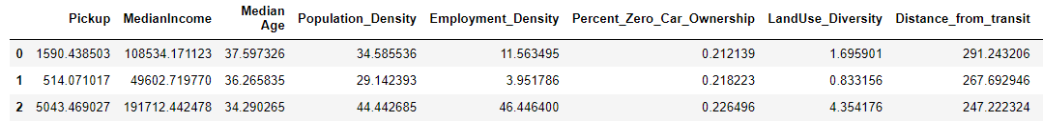
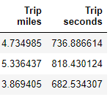
Output
There are three clusters of census tracts:
There is the high-income group consisting of people around aged 34, median income 191k$, living close to transit who around travel 3.86 miles, and where 22% don’t own cars.
There is the medium income group consisting of people around aged 37, median income 108k$, living a bit further to transit who around travel 4.7 miles, and where 21% don’t own cars.
There is the low-income group consisting of people around aged 36, median income 49k$, living close to transit who around travel 5.36 miles, and where 21% don’t own cars.

Slide 25
Future Roadmap
1. Work with one year’s data instead of July 2020.
2. Create different clusters using different time frames based on covid-phases.
3. Incorporate more variables based on the relationship between distance to transit and pickups, etc.

Slide 26
References
1. Varone, L.R., 2018. Understanding Spatiotemporal Growth of Ride Source Services In New York City. University of Connecticut.
2. City of Chicago Data Portal, 2021. Transportation Network Providers - Trips.
3. Smart Location Database, Environmental Protection Agency. https://www.epa.gov/smartgrowth/smart-location-mapping
4. K-means clustering: Framework Source: https://medium.datadriveninvestor.com/k-means-clustering-b89d349e98e6
5. Analyzing the Results of K-means Clustering. https://openclassrooms.com/en/courses/5869986-perform-an-exploratory-data-analysis/6177861-analyze-the-results-of-a-k-means-clustering#:~:text=Interpreting%20the%20meaning%20of%20k,of%20what%20each%20cluster%20represents.

